Slide 1

Tellurium Mining Data Analytics
Kathryne Reed
Colorado State University Global
MIS581 Enterprise Performance Management
Professor Steve Chung
09/10/2023

Slide 2
Introduction
Tellurium, a relatively rare element, has several important industrial and technological applications:
Solar Panels: One of the most significant uses of tellurium is in the production of thin-film solar cells. Tellurium is a crucial component in these solar cells, helping convert sunlight into electricity.
Alloying Agent: Tellurium enhances machinability without significantly affecting electrical conductivity.
Semiconductor Industry: Tellurium is used in the semiconductor in the production of acousto-optic devices, which are essential for telecommunications and laser technology.
These applications highlight the importance of tellurium in renewable energy, metallurgy, and advanced technology, making it a valuable element in various industries.
Notes:
As technology continues to grow, so does the ability to gather the necessary elements. The mining of tellurium peaked my interest while looking for datasets to use in this course and I thought this was very pertinent to the growing use of solar panels and other technology that uses tellurium. It was also something that I knew very little about and I wanted to learn more through observing the data and understanding the background. I was able to come up with research questions based on the data that was available in the dataset after diving in.
The availability of critical minerals plays a vital role in various strategic, consumer, and commercial applications. One such mineral is tellurium, which finds extensive use in Cd-Te film solar cells, alloying additives in steel and copper, and catalysts in synthetic fiber production. Understanding the distribution and availability of tellurium resources in the United States is of great importance, given its significance in multiple industries.

Slide 3
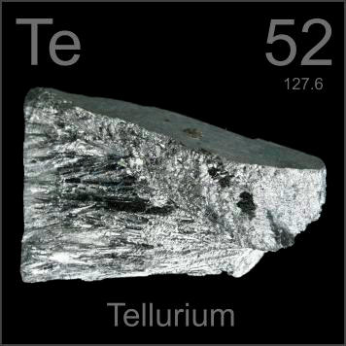

Abstract
The study aims to address critical questions regarding the weights of tellurium mined compared to other materials, the purity significance of materials mined, and the length of time that a mine is expected to be viable.
These insights can inform decisions related to tellurium utilization, domestic production, and resource exploration.
Quantitative methodologies and SAS for data analysis
Notes:
This slide is an abstract of our research. The primary goal is to explore the availability, purity, and viability of Tellurium resources in the United States. I jumped into an available dataset to answer critical questions and offer practical insights for stakeholders.
This study had several limitations, the primary being, the lack of data available in the dataset and the difficulty in comparing data points to one another.
SAS was used to load and analyze this data because it is free to use as a student and my latest courses have given me more experience with this tool.

Slide 4

Research Objectives
Main research objectives are to:
Analyze Tellurium's weight compared to other materials mined.
Investigate the grading value (purity) of Tellurium compared to copper.
Evaluate the average age of Tellurium mines in relation to the industry average of 70 years.
Notes:
The main objectives of this analysis is aimed to analyze the weight of Tellurium compared to other materials, assess its grading value compared to copper, and evaluate the average age of Tellurium mines in relation to industry standards.

Slide 5

Methodology
Quantitative analysis using SAS
This approach allowed me to quantify variables, assess correlations, and extract statistical significance.
Limitations of the dataset size and my coding abilities were a challenge.
Notes:
Quantitative analysis was chosen due to its suitability for extracting meaningful insights from the available dataset.
The primary tool utilized for data analysis was SAS (Statistical Analysis System), a versatile platform for statistical analysis and data visualization. Due to my familiarity with it and convenience of use as a student for free.
However, it is essential to acknowledge certain limitations, including the finite nature of the dataset and the potential constraints of coding skills. Despite these challenges, the quantitative approach provided the ability for meaningful findings, shedding light on various facets of tellurium mining, its economic viability, environmental impact, and technological innovations.

Slide 6
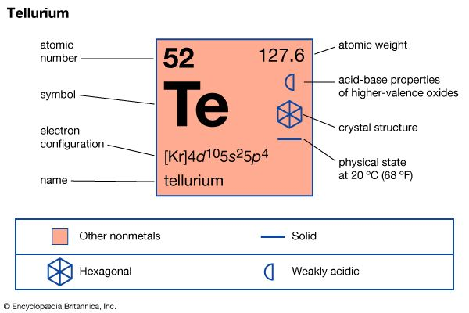
Research Questions and Hypotheses
Is Tellurium the most weighty material mined in the U.S.?
How does Tellurium's grading value compare to that of copper's?
What is the average age of Tellurium mines?
Hypotheses involve null and alternative hypotheses for each research question.
Notes:
These questions revolve around Tellurium's weight, grading value, and mine age compared to industry averages. The idea of these questions were based on what was available to be tested in the dataset. When comparing the weight of the material mined, we can then apply this information to the cost to transport it after mined, or even the expenditures associated with just acquiring the weight of material.
The purity (grading) of the material is very important. Since coper is mined alongside tellurium, the purity of the material compared to each other, can help better understand if one is related to the other and advise future mining based on small tests. This is an example of one question being simple and potentially leading to more questions later on.
Since the average age of a copper mine is 70 years, we want to understand it this stands true for the average age of tellurium mines as well. This will give us a good comparison. Running a t test on it will allow us to see if it is significant in the difference or not.

Slide 7
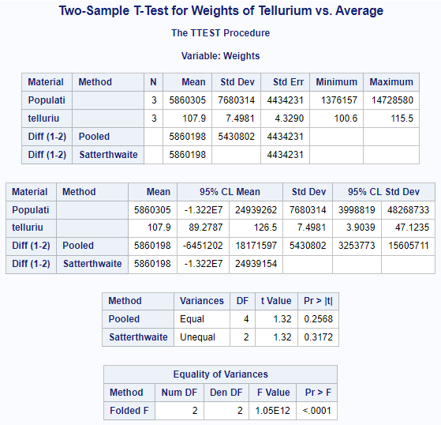
Is Tellurium the most weighty material mined in the U.S.?
H0: average weight of tellurium = average weight of all other materials
Ha: average weight of tellurium > average weight of all other materials.
Notes:
Here we looked at the average weight of tellurium and the average weight of all materials mined in this dataset and ran a two sample t test which resulted in a p value <0.0001.
Based on this chart, we see the P value is less than 0.0001, meaning it is smaller than 0.05 meaning that we accept the null hypothesis and reject the alternate hypothesis in this scenario. This is very interesting given the values of the materials that are extracted from the mines. This means that tellurium is mined at far smaller amounts than the average mined material weight in this dataset. It probably makes sense with the cost of this material in relation to supply and demand.

Slide 8
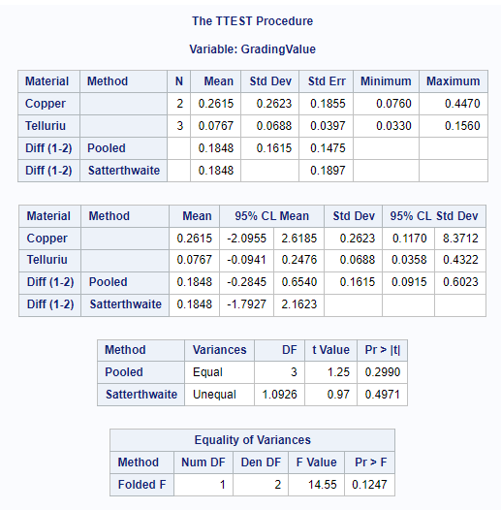
How does Tellurium's grading value compare to that of copper's?
H0: The grading value for tellurium is not significantly different than the grading value for copper in this data set.
Ha: The grading value for tellurium is significantly different than the grading value for copper in this data set.
Notes:
Here we looked at the grading of tellurium and the grading of copper and ran a t test to look at if there is a significant difference between them.
Based on the results of the p-value not being less than 0.05 we accept the null and reject the alternate hypothesis that the grading value for tellurium is significantly different than the grading value for copper in this data set. This means that there is not a significant difference in the purity of these two materials. Since copper is mined directly in line with tellurium in these mines, this gives us more insight into the mining of these materials at the same time. This means that if they are mined at an acceptable purity, then it could be assumed that they both would meet the purity standards needed. This kind of information would be very helpful when looking at a mine and understanding what kind of purity of materials could be pulled out and how that might relate to the cost to mine it. The balance there might make or break a financial investment decision to a business running a mine.

Slide 9
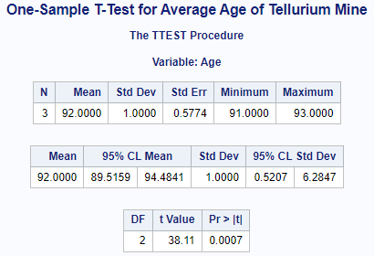
What is the average age of Tellurium mines?
H0: The average age of a tellurium mine is not less than 70 years.
Ha: The average age of a tellurium mine is less than 70 years.
Notes:
Here we looked at the researched, average age of 70 years for a copper mine, and the average age of tellurium mines in this dataset and then ran a t test to compare for significance.
Based on this information, we can see that the p value for average age of the mines is less that 0.0007 which would indicate that we should reject the null and accept the alternate hypothesis that the average age of tellurium mines is greater than the average age of a coper mine at 70 years. This is interesting as it is higher than the average age of a mine of 70 years. As a business this would be good information to know and use when choosing which mines to invest in. they would consider how long they could mine in one mine for this material compared to other materials that would have a shorter life expectancy.

Slide 10

Findings
Allow us to understand more about tellurium mining
Allow us to answer basic questions and dive into more specific questions
Opens the door for data collection improvement
Notes:
The findings of these research questions allow for guided directions on asking further questions to learn more information that could empower stakeholders with information to make informed decisions. The analysis of the dataset will serve as a valuable stepping stone for further research in the field of tellurium resource exploration and management. Additionally, the research can contribute to the knowledge base on tellurium's distribution in purities, length of possible mining history, and how the percentage of mining tellurium compares to other materials mined in the same locations further enriching the understanding of its occurrence and availability.

Slide 11

Future
Better data collection
Larger dataset
More data points
Question guided research structure
More skilled analyst
Notes:
During this process, I discovered a few things that I would share as recommendations for this kind of research in the future and that would be to have better data collection from the beginning. With a more robust dataset, we have the ability to ask and analyze more questions that can better influence business decisions in better reality.
I also would suggest basing the data collection off of a few questions to begin with, so there is a direction that the data is going.
For an analyst, more experience with coding will be very helpful, so results could be analyzed faster and shared faster with business leaders.

Slide 12
References
Bhore, S. J., & Johnson, R. G. (2020). Critical mineral resources of the United States—Economic and environmental geology and prospects for future supply. U.S. Geological Survey Professional Paper 1802. https://doi.org/10.3133/pp1802
Burt, D. M., & Mosier, D. L. (2009). The tellurium- and selenium-enriched copper deposits of southwestern Montana, USA. Mineralium Deposita, 44(7), 765–791. https://doi.org/10.1007/s00126-009-0251-8
Bustamante, M. L., Gaustad, G., & Alonso, E. (2017). Comparative analysis of Supply Risk-mitigation strategies for critical byproduct minerals: A case study of tellurium. Environmental Science &amp; Technology, 52(1), 11–21. https://doi.org/10.1021/acs.est.7b03963
Nassar, N. T., Kim, H., Frenzel, M., Moats, M. S., & Hayes, S. M. (2022). Global tellurium supply potential from electrolytic copper refining. Resources, Conservation and Recycling, 184, 106434. https://doi.org/10.1016/j.resconrec.2022.106434
U.S. Geological Survey. (2019). Mineral commodity summaries 2019. U.S. Geological Survey. https://doi.org/10.3133/70202434
Pandey, G., & Bajpai, S. (2022). Accessing the environmental impact of tellurium metal. Physical Sciences Reviews, 0(0). https://doi.org/10.1515/psr-2021-0113
Whitworth, A. J., Forbes, E., Verster, I., Jokovic, V., Awatey, B., & Parbhakar-Fox, A. (2022). Review on advances in mineral processing technologies suitable for critical metal recovery from mining and Processing Wastes. Cleaner Engineering and Technology, 7, 100451. https://doi.org/10.1016/j.clet.2022.100451

